Slide 1
SQL MSBA BAN 6020 Data Management
Carolina Salge

Slide 2
SQL
A standard for relational database
American National Standards Institute (ANSI)
International Organization for Standardization (ISO)
SQL skills are in demand
Developed by IBM
Object-oriented extensions created

Slide 3
SQL
Complete database language
Definition—create
Manipulation—select, insert, update, delete
Control—grant and revoke

Slide 4
Definition

Slide 5
Define a Table
create table dept (
deptname varchar(15),
deptfloor smallint not null,
deptphone smallint not null,
empno smallint not null,
primary key(deptname));
create table empno (
empno smallint,
empfname varchar(10),
empsalary decimal(7,0),
deptname varchar(15),
bossno smallint,
primary key(empno),
constraint fk_has_dept foreign key(deptname) references dept(deptname)),
constraint fk_has_boss foreign key(bossno) references emp(empno));
There is not foreign key constraint for empno in dept, because it requires the matching primary key in emp exist. However, the matching foreign key in emp can't be created until the matching primary key in dept exists. An infinite circle of references.

Slide 6
Define a View
A virtual table created from existing tables
View template
Restrict access to the table share
Create a view with stock’s yield computed
create view <VIEW> as <SUBQUERY>
create view stkfp as select stkfirm, stkprice from stock
create view stk as select stkfirm, stkprice, stkqty, stkdiv/stkprice*100 from stock

Slide 7
Why Views
Avoid writing common SQL queries
Create a view to perform the frequent join between stock and nation and to convert all share prices from the local currency to British pounds
create view stkvalue as select natname, stkfirm, stkprice*exchrate, stkqty, stkqty*stkprice*exchrate
from stock, nation where stock.natcode = nation.natcode;
# Drop a view
drop view stkvalue;
Notes:
Does a view get automatically updated when I update either of the two tables (nation or stock) or I add records to either of them? If the update you made to underlying tables is adding or deleting data, then the view is auto updated with the new data. If you add or delete the columns form the underlying tables (basically the definition of the view ), then you need to update the view to reflect the new schema.

Slide 8
Exercise
What is the percentage of Australian stocks in the portfolio?
Create two views and write a query

Slide 9
Define an Index
An ordered set of pointers to rows of a table
Index template
Create a unique index for firm name
create <unique> index <COLUMN> on <TABLE> <(COLUMN)>
create unique index firmname on share (shrfirm);

Slide 10
Why Indexes
Speed up database search
If you have a book on countries and are looking for Brazil, do not flip through the entire book. Instead, read the index at the back of the book to find the exact pages with information about Brazil
# Drop an index
drop index firmname;

Slide 11
Manipulation

Slide 12
Insert Rows
insert into emp (empno, empfname, empsalary, deptname)
values (1,'Alice', 75000,'Management');
insert into emp values (2,'Ned', 45000,'Management');
insert into emp values (3,'Andrew',25000, 'Marketing');
insert into emp values (4,'Clare', 22000, 'Marketing');
insert into emp values (5,'Todd', 38000, 'Accounting');
insert into emp values (6,'Nancy', 22000,'Accounting');
insert into emp values (7,'Brier', 43000,'Purchasing');
insert into emp values (8,'Sarah', 56000,'Purchasing');
insert into emp values (9,'Sophie', 35000,'Personnel');
Order inserts to avoid referential integrity issues

Slide 13
Update and Delete
Change the share price of FC to 31.50
Erase the Burmese Elephant data since all shares were sold
update share set shrprice = 31.50
where shrcode = 'FC';
delete from share where shrfirm = 'Burmese Elephant';

Slide 14
Select
Template
select <distinct> <count, sum, avg, min, max> <COLUMNS>
from <TABLES>
where <CONDITIONS>
group by <COLUMNS>
having <CONDITIONS>
order by <COLUMNS>
# example
select * from share where shrpe >= 12
order by shrpe desc, shrfirm;

Slide 15
Format
Numbers
round(x,d) formats x with d decimal places
Dates
date_format(date, format) gives flexibility
select round(amount,2) from payments;
select date_format(orderDate, '%W, %M %Y') from Orders;
select date_format(orderDate, '%Y-%m-%d') from Orders;
select date_format(orderDate, '%D, %M %Y') from Orders;

Slide 16
Collation Sequence
Sorting of characters in a language
English
A B C … X Y Z
Norwegian
A B C … X Y Z Æ Ø Å
Specify a collation sequence at any level
Good practice to set at the database level
create database ClassicModels collate latin1_general_cs;
# cs indicates case sensitivity

Slide 17
Join
New table from two existing tables
Match tables on a common column

Slide 18
Inner Join
Tables have two identical columns
select * from stock, nation
where stock.natcode = nation.natcode;
nation
stock

Slide 19
Left Outer Join
Inner join + rows in person not in the join
select `person first`, `person last`, carid, cartype
from person left join car using (personid)
order by carid;
person
car

Slide 20
Right Outer Join
Inner join + rows in item not in the join
select itemno, itemname, itemtype, itemcolor, saleno
from lineitem right join item using (itemno)
order by saleno;
lineitem
item

Slide 21
Full Outer Join
Inner join plus rows in t1 and t2 not in the join
select id, col1, col2 from t1 left join t2 using (id)
union
select id, col1, col2 from t1 right join t2 using (id);
t1
t2

Slide 22
Exercises
What questions are you answering with the two queries below and what are other ways to write them?
select `person first`, `person last`, carid, cartype
from person left join car using (personid)
order by carid;
select itemno, itemname, itemtype, itemcolor, saleno
from lineitem right join item using (itemno)
order by saleno;

Slide 23
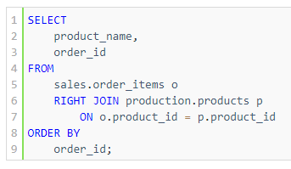
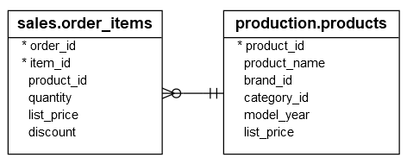
Exercise
What about this query?

Slide 24
Note to Carolina
Stop here! Finish chapter 10 next class

Slide 25
Correlated Subqueries
Solves the inner query many times
Find stocks where their quantity is greater than the average quantity for their country
select natname, shrfirm, stkqty from stock, nation
where stock.natcode = nation.natcode and stkqty >
(select avg(stkqty) from stock
where stock.natcode = nation.natcode);
natname | stkfirm | stkqty
Australia | Queensland Diamond | 89251
United Kingdom | Bolivian Sheep | 231678
United Kingdom | Royal Ostrich Farms | 1234923
United States | Minnesota Gold | 816122

Slide 26
Correlated Subquery
nation
natcode | natname | exchrate
UK | United Kingdom | 1.00
USA | United States | 0.67
AUS | Australia | 0.46
IND | India | 0.0228
select natname, shrfirm, stkqty from stock, nation
where stock.natcode = nation.natcode and stkqty >
(select avg(stkqty) from stock
where stock.natcode = nation.natcode);
stock
stkcode | stkfirm | stkprice | stkqty | stkdiv | stkpe | natcode
FC | Freedonia Copper | 27.50 | 10529 | 1.84 | 16 | UK
PT | Patagonian Tea | 55.25 | 12635 | 2.50 | 10 | UK
AR | Abyssinian Ruby | 31.82 | 22010 | 1.32 | 13 | UK
SLG | Sri Lankan Gold | 50.37 | 32868 | 2.68 | 16 | UK
ILZ | Indian Lead &Zinc | 37.75 | 6390 | 3.00 | 12 | UK
BE | Burmese Elephant | .07 | 154713 | 0.01 | 3 | UK
BS | Bolivian Sheep | 12.75 | 231678 | 1.78 | 11 | UK
NG | Nigerian Geese | 35.00 | 12323 | 1.68 | 10 | UK
CS | Canadian Sugar | 52.78 | 4716 | 2.50 | 15 | UK
ROF | Royal Ostrich Farms | 33.75 | 1234923 | 3.00 | 6 | UK
MG | Minnesota Gold | 53.87 | 816122 | 1.00 | 25 | USA
GP | Georgia Peach | 2.35 | 387333 | .20 | 5 | USA
NE | Narembeen Emu | 12.34 | 45619 | 1.00 | 8 | AUS
QD | Queensland Diamond | 6.73 | 89251 | .50 | 7 | AUS
IR | Indooroopilly Ruby | 15.92 | 56147 | .50 | 20 | AUS
BD | Bombay Duck | 25.55 | 167382 | 1.00 | 12 | IND

Slide 27
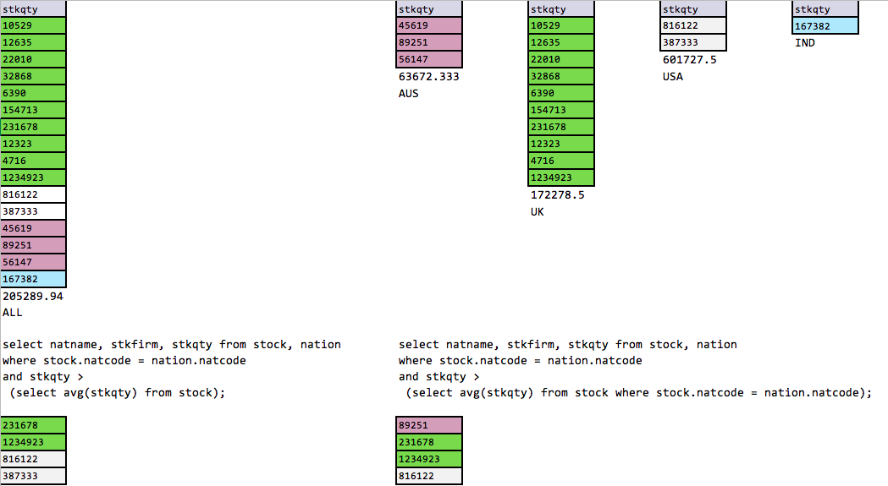
Subquery vs. Correlated Subquery

Slide 28
Security
Data is a valuable resource
Access should be controlled
SQL security procedures
create view
Authorization commands

Slide 29
Grant
Template
with grant option
Allows a user to pass privileges to another user
grant <all privileges, select, update, delete, insert>
on <TABLES> <VIEWS>
to <USERS> <public>
with grant option;

Slide 30
Grant
Give Alice all rights to the stock table
Allow Todd and Nancy to update stock price
Give all staff the privilege to select from item
grant all privileges on stock to Alice;
grant update (stkprice) on stock to Todd, Nancy;
grant select on item to public;

Slide 31
Revoke
Removes privileges
Template
Cascading revoke
Reverses use of the with grant option
Users whose privileges were established using with grant option are also revoked
revoke privileges on <TABLES> <VIEWS> from <USERS>;

Slide 32
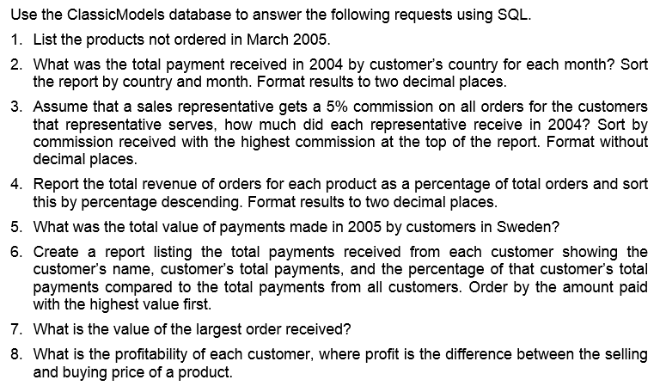
Exercises – Classic Models

Slide 33
Question 1
SELECT productName
FROM Products
WHERE productCode NOT IN (SELECT productCode FROM OrderDetails, Orders WHERE Orders.orderNumber = OrderDetails.orderNumber AND YEAR(orderDate) = 2005 AND monthname(orderDate) = 'March')

Slide 34
Question 2
SELECT country, MONTHNAME(paymentDate) AS MONTH, ROUND(SUM(amount),2) AS
Total FROM Payments, Customers
WHERE Payments.customerNumber = Customers.customerNumber
AND YEAR(paymentDate) = 2004
GROUP BY country, MONTH
ORDER BY country, MONTH(paymentDate)

Slide 35
Question 3
SELECT firstName, lastName, FORMAT(sum(quantityOrdered*priceEach)*.05,0)
AS Commission FROM OrderDetails, Orders, Customers, Employees WHERE Orders.orderNumber = OrderDetails.orderNumber
AND Customers.customerNumber = Orders.customerNumber
AND Customers.salesRepEmployeeNumber = Employees.employeeNumber
AND YEAR(orderDate) = 2004
GROUP BY firstName, lastName
ORDER BY sum(quantityOrdered*priceEach) desc

Slide 36
Question 4
SELECT productName, ROUND(sum(quantityOrdered*priceEach)/(SELECT
sum(quantityOrdered*priceEach) FROM OrderDetails)*100,2) AS Percentage
FROM OrderDetails, Orders, Products
WHERE Orders.orderNumber = OrderDetails.orderNumber
AND Products.productCode = OrderDetails.productCode
GROUP BY productName
ORDER BY Percentage desc

Slide 37
Question 5
SELECT sum(amount) FROM Payments, Customers
WHERE Payments.customerNumber = Customers.customerNumber
AND country = 'Sweden'
AND YEAR(paymentDate) = 2005

Slide 38
Question 6
SELECT customerName, ROUND(sum(amount),2) AS Total, round(sum(amount)/(SELECT SUM(amount) FROM Payments)*100,2) AS Percent
FROM Payments, Customers
WHERE Customers.customerNumber = Payments.customerNumber
GROUP BY customerName
ORDER BY sum(amount) DESC;

Slide 39
Question 7
SELECT ROUND(max(orderAmount),2) FROM
(SELECT customerNumber, Orders.orderNumber, sum(quantityOrdered*priceEach) AS orderAmount FROM Orders, OrderDetails
WHERE Orders.orderNumber = OrderDetails.orderNumber
GROUP BY customerNumber, Orders.orderNumber) AS tempTable;

Slide 40
Question 8
SELECT customerName, ROUND(SUM(quantityOrdered*(priceEach - buyPrice)),0) AS Profit FROM Products, Orders, OrderDetails, Customers WHERE Products.productCode = OrderDetails.productCode
AND OrderDetails.orderNumber = Orders.orderNumber
AND Customers.customerNumber = Orders.customerNumber
GROUP BY CustomerName
ORDER BY SUM(quantityOrdered*(priceEach - buyPrice)) DESC;

Slide 41
Recap
Introduced
Views and Indexes
Format and Dates
Left Outer, Right Outer, and Full Outer Join
Grant and Revoke
Reviewed
Inner Join
Create, Select, Insert, Update, and Delete
Subquery and Correlated Subquery

Slide 42
Next Class
Project Review

